Slide 1

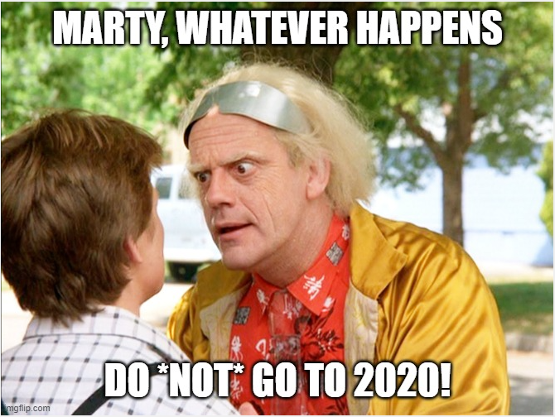

Burnout
more than just a bad day!
Seth Petry-Johnson

Slide 2
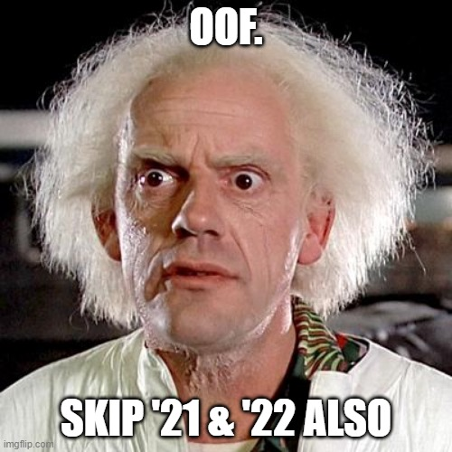
Burnout
more than just a bad day!
Seth Petry-Johnson

Slide 3
Burnout
more than just a bad day!
Seth Petry-Johnson

Slide 4

Burnout
more than just a bad day!
Seth Petry-Johnson
Employed Americans reporting worker burnout
76%

Slide 5
Burnout
more than just a bad day!
Seth Petry-Johnson
Employed Americans reporting complete burnout
9%

Slide 6
Burnout
more than just a bad day!
Seth Petry-Johnson
Employed Americans w/ no ideas for reducing burnout
1 in 10
Today’s agenda
Understanding burnout
Diagnosing and measuring burnout
Treating / managing burnout

Slide 7
Burnout
more than just a bad day!
Seth Petry-Johnson
Employed Americans w/ no ideas for reducing burnout
1 in 10
Today’s agenda
Understanding burnout
Diagnosing and measuring burnout
Treating / managing burnout

Slide 8
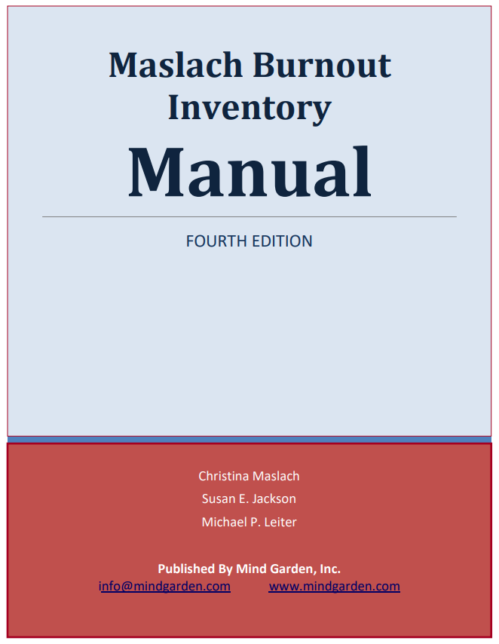
Burnout
more than just a bad day!
Seth Petry-Johnson
Understanding burnout
Today’s agenda
Diagnosing and measuring burnout
Treating / managing burnout

Slide 9
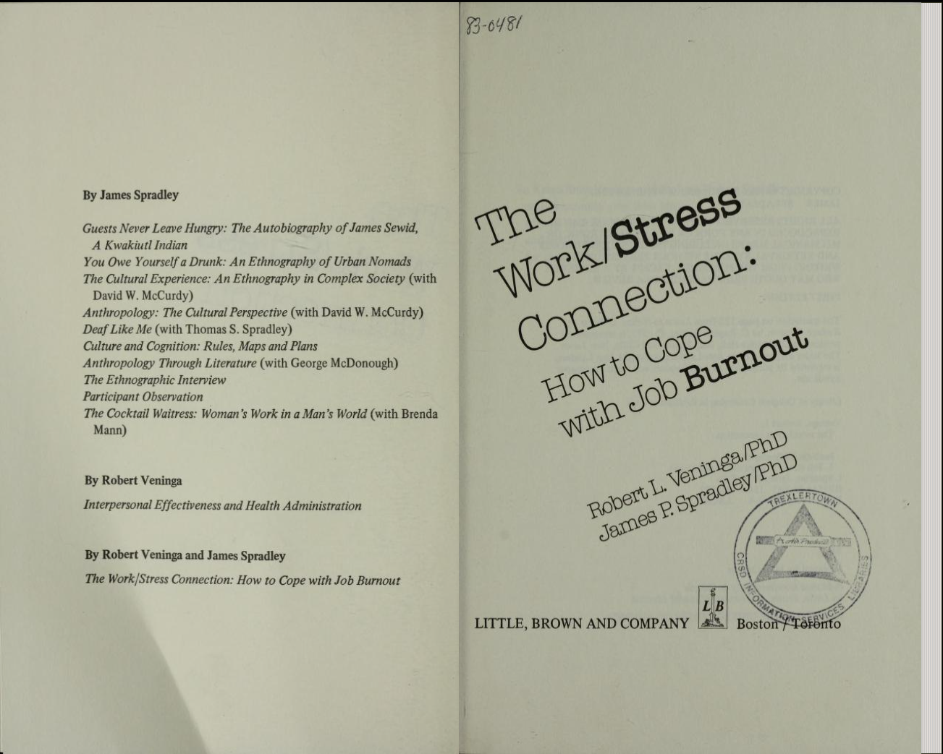
Burnout
more than just a bad day!
Seth Petry-Johnson
Understanding burnout

Slide 10
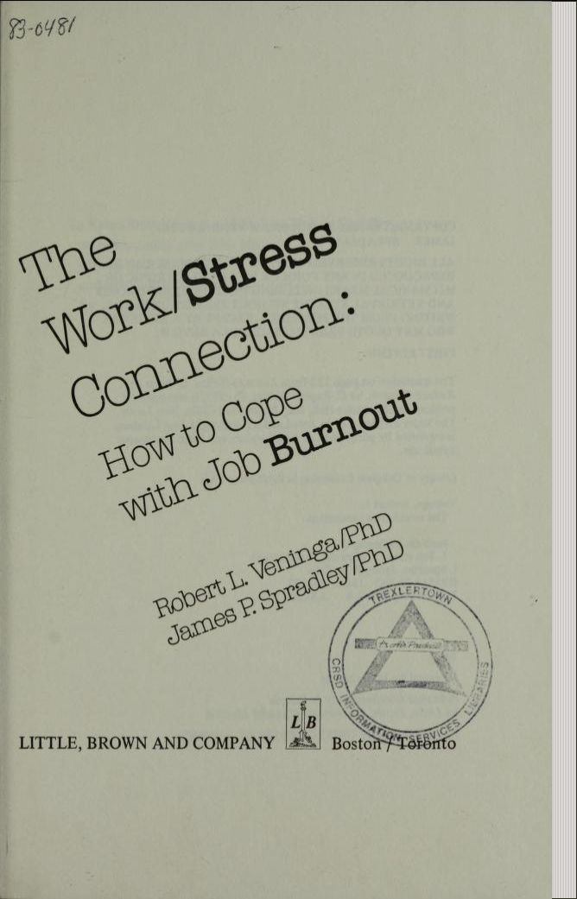
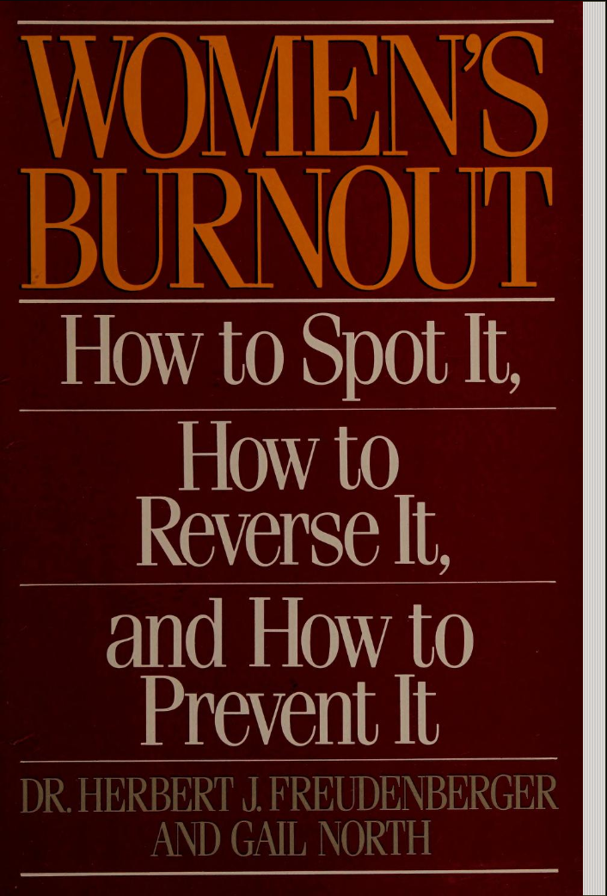
Burnout
more than just a bad day!
Seth Petry-Johnson
Understanding burnout

Slide 11
Burnout
more than just a bad day!
Seth Petry-Johnson
Understanding burnout

Slide 12
Burnout
more than just a bad day!
Seth Petry-Johnson
Understanding burnout
Burnout is a syndrome,
not a specific diagnosis

Slide 13
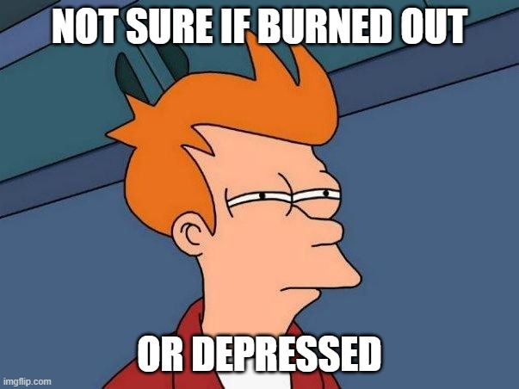
Burnout
more than just a bad day!
Seth Petry-Johnson
Understanding burnout
Burnout is a syndrome,
not a specific diagnosis
A syndrome is a group of symptoms that consistently occur together
Veninga and Spradley 5 stages

Slide 14

Burnout
more than just a bad day!
Seth Petry-Johnson
Understanding burnout
Burnout is a syndrome,
not a specific diagnosis
A syndrome is a group of symptoms that consistently occur together
Veninga and Spradley 5 stages

Slide 15
Burnout
more than just a bad day!
Seth Petry-Johnson
Understanding burnout
Burnout is a syndrome,
not a specific diagnosis
A syndrome is a group of symptoms that consistently occur together
Veninga and Spradley 5 stages
Burnout symptoms accompany chronic unmanaged stress
in the workplace

Slide 16


Burnout
more than just a bad day!
Seth Petry-Johnson
Veninga and Spradley 5 stages of workplace burnout
Honeymoon
High job satisfaction
Commitment / energy / creativity
Stress feels like “good stress”; we don’t recognize adaptation energy being used up

Slide 17

Burnout
more than just a bad day!
Seth Petry-Johnson
Veninga and Spradley 5 stages of workplace burnout
Fuel Shortage
Honeymoon
Begin to overdraw adaptation energy
Vague feeling of loss
“Balancing act”

Slide 18

Burnout
more than just a bad day!
Seth Petry-Johnson
Veninga and Spradley 5 stages of workplace burnout
Fuel Shortage
Chronic Symptoms
Honeymoon
Chronic exhaustion
Physical illness
Anger / depression

Slide 19

Burnout
more than just a bad day!
Seth Petry-Johnson
Symptoms become critical
Pessimism and self-doubt
“Escape mentality”
Veninga and Spradley 5 stages of workplace burnout
Fuel Shortage
Chronic Symptoms
Honeymoon
Crisis

Slide 20
Burnout
more than just a bad day!
Seth Petry-Johnson
Veninga and Spradley 5 stages of workplace burnout
Burnout transitions into significant and persistent physical or emotional problems
Fruedenberger’s 12 stages
Fuel Shortage
Chronic Symptoms
Hitting the Wall
Honeymoon
Crisis

Slide 21
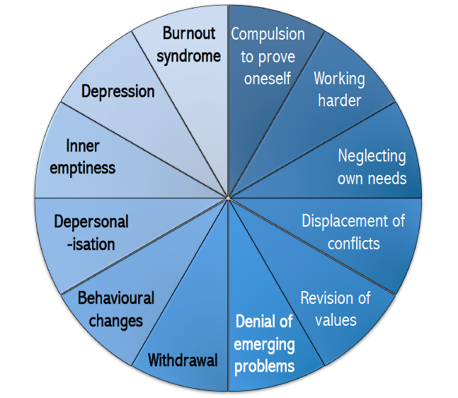
Burnout
more than just a bad day!
Seth Petry-Johnson
Veninga and Spradley 5 stages of workplace burnout
Fruedenberger’s 12 stages
Hitting the Wall
Honeymoon
→
Maslach Burnout Inventory 3 scales for measuring burnout

Slide 22

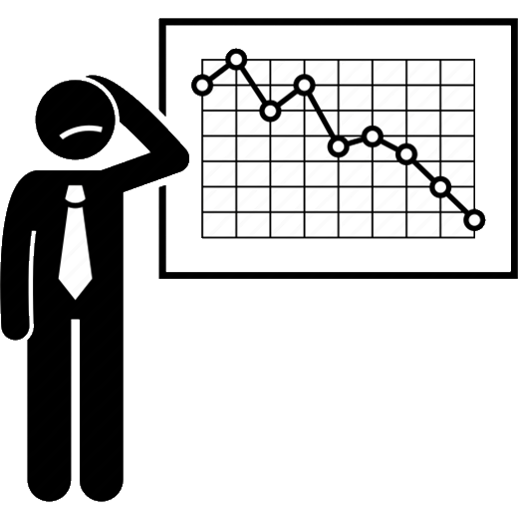
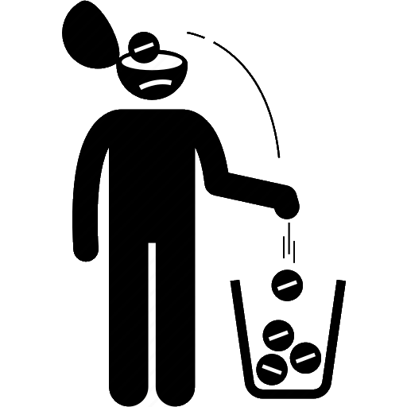
Burnout
more than just a bad day!
Seth Petry-Johnson
Veninga and Spradley 5 stages of workplace burnout
Maslach Burnout Inventory 3 scales for measuring burnout
Fruedenberger’s 12 stages
Hitting the Wall
Honeymoon
→
Exhaustion
Low Professional Efficacy
Cynicism

Slide 23
Burnout
more than just a bad day!
Seth Petry-Johnson
Maslach Burnout Inventory 3 scales for measuring burnout
Feelings related to work, not symptoms
Low Professional Efficacy
Exhaustion
Cynicism
Worn out by work
Energized by work
My work doesn’t matter
My work is valuable

Slide 24
Burnout
more than just a bad day!
Seth Petry-Johnson
Maslach Burnout Inventory 3 scales for measuring burnout
Measured on a spectrum
Low Professional Efficacy
Exhaustion
Cynicism
Worn out by work
Energized by work
My work doesn’t matter
My work is valuable

Slide 25
Burnout
more than just a bad day!
Seth Petry-Johnson
Maslach Burnout Inventory 3 scales for measuring burnout
Measured on a spectrum
Low Professional Efficacy
Exhaustion
Cynicism
Worn out by work
Energized by work
My work doesn’t matter
My work is valuable
I’m not good at my job
I make a difference

Slide 26
Burnout
more than just a bad day!
Seth Petry-Johnson
Maslach Burnout Inventory 3 scales for measuring burnout
Measured on a spectrum
Low Professional Efficacy
Exhaustion
Cynicism
Worn out by work
Energized by work
My work doesn’t matter
My work is valuable
I’m not good at my job
I make a difference

Slide 27


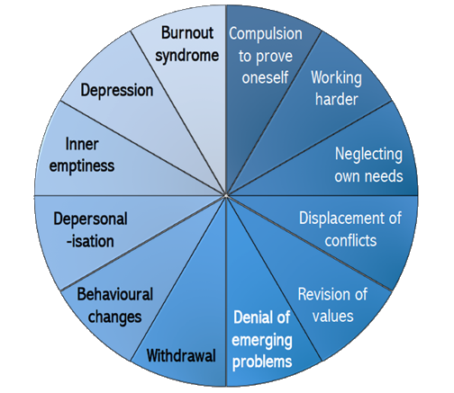

Burnout
more than just a bad day!
Seth Petry-Johnson
3 models of burnout
Low Professional Efficacy
Exhaustion
3 separate feelings
Progressively worsening symptoms
Worn out by work
Energized by work
I’m not good at my job
I make a difference
Cynicism
My work doesn’t matter
My work is valuable

Slide 28
Burnout
more than just a bad day!
Seth Petry-Johnson
Measuring burnout
Progressively worsening symptoms
Worn out by work
Energized by work

Slide 29
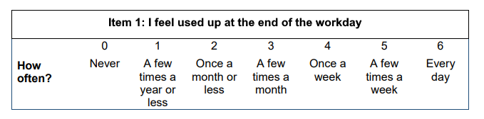
Burnout
more than just a bad day!
Seth Petry-Johnson
Measuring burnout
Burnout Inventory
Areas of Worklife Survey
Measures 3 types of feelings to
provide a burnout “score”
Suggests reasons for burnout due to mismatch w/ key aspects of job/role
Exhaustion

Slide 30
Burnout
more than just a bad day!
Seth Petry-Johnson
Measuring burnout
Areas of Worklife Survey
Suggests reasons for burnout due to mismatch w/ key aspects of job/role
Exhaustion
Burnout Inventory
Measures 3 types of feelings to
provide a burnout “score”
Cynicism

Slide 31
Burnout
more than just a bad day!
Seth Petry-Johnson
Measuring burnout
Areas of Worklife Survey
Exhaustion
Suggests reasons for burnout due to mismatch w/ key aspects of job/role
Cynicism
Burnout Inventory
Measures 3 types of feelings to
provide a burnout “score”
Professional Efficacy

Slide 32
Burnout
more than just a bad day!
Seth Petry-Johnson
Measuring burnout
Exhaustion
Areas of Worklife Survey
Suggests reasons for burnout due to mismatch w/ key aspects of job/role
Cynicism
Burnout Inventory
Measures 3 types of feelings to
provide a burnout “score”
Professional Efficacy

Slide 33

Burnout
more than just a bad day!
Seth Petry-Johnson
Measuring burnout
Psychometrically sound
Easy to administer (10 -15 min)
Specialized versions for specific fields
Human Services
(MBI-HSS)
Medical Personnel
(MBI-HSS MP)
Education / Schools
(MBI-ES)
General Survey
(MBI-GS)

Slide 34
Burnout
more than just a bad day!
Seth Petry-Johnson
Measuring burnout
(MBI-GS)

Slide 35
Burnout
more than just a bad day!
Seth Petry-Johnson
Measuring burnout
(MBI-GS)

Slide 36
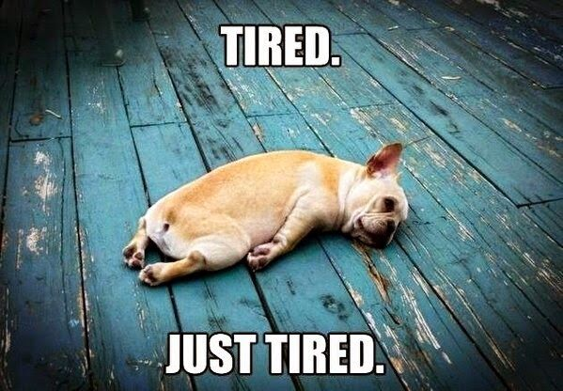
Burnout
more than just a bad day!
Seth Petry-Johnson
Understanding burnout
Burnout symptoms:
Depleted energy reserves
Pervasive feeling of exhaustion

Slide 37
Burnout
more than just a bad day!
Seth Petry-Johnson
Understanding burnout
Burnout symptoms:
Depleted energy reserves
Hard to get out of bed in the morning

Slide 38
Burnout
more than just a bad day!
Seth Petry-Johnson
Understanding burnout
Burnout symptoms:
Depleted energy reserves
Loss of interest in leisure activities

Slide 39
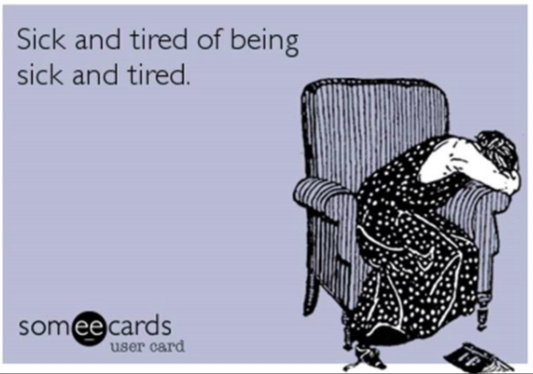
Burnout
more than just a bad day!
Seth Petry-Johnson
Understanding burnout
Burnout symptoms:
Depleted energy reserves
Withdrawal from relationships /
“No fun to be around”

Slide 40
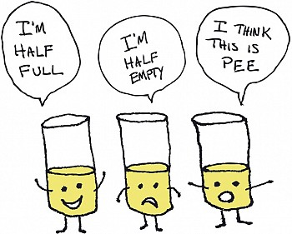
Burnout
more than just a bad day!
Seth Petry-Johnson
Understanding burnout
Burnout symptoms:
Depleted energy reserves
Lowered resistance to illness

Slide 41
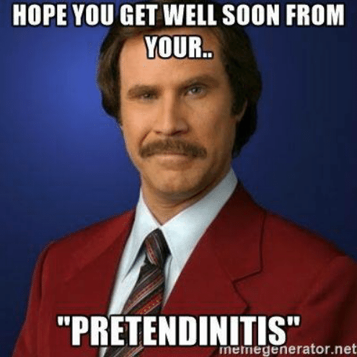
Burnout
more than just a bad day!
Seth Petry-Johnson
Understanding burnout
Burnout symptoms:
Depleted energy reserves
Lowered resistance to illness
Increased dissatisfaction and pessimism

Slide 42
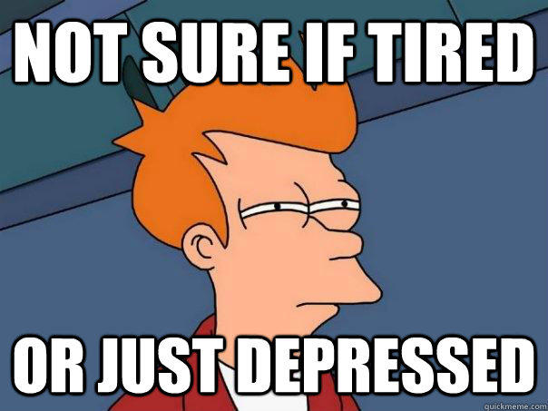
Burnout
more than just a bad day!
Seth Petry-Johnson
Understanding burnout
Burnout symptoms:
Depleted energy reserves
Lowered resistance to illness
Increased dissatisfaction and pessimism
Increased absenteeism and inefficiency at work

Slide 43
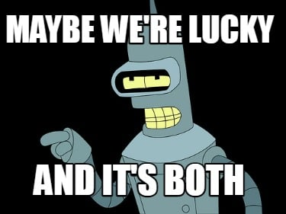
Burnout
more than just a bad day!
Seth Petry-Johnson
Understanding burnout
Burnout symptoms:
Depleted energy reserves
Lowered resistance to illness
Increased dissatisfaction and pessimism
Increased absenteeism and inefficiency at work

Slide 44
Burnout
more than just a bad day!
Seth Petry-Johnson
Understanding burnout
Burnout is a syndrome of three types of feelings:
Emotional exhaustion
Depersonalization
Low personal accomplishment

Slide 45

Burnout
more than just a bad day!
Burnout is a state of
emotional, physical, and mental exhaustion
caused by excessive and prolonged stress
Today’s agenda
Understanding burnout
Diagnosing and evaluating burnout
Treating / managing burnout

Slide 46
Burnout
more than just a bad day!
Burnout is a state of
emotional, physical, and mental exhaustion
caused by excessive and prolonged stress
Pandemic
Inflation
Politics
Job insecurity
Family stress
WFH / RTO
Adulting
Turnover

